Slide 1



The [KYR] Project
A detailed look of the project to date

Slide 2

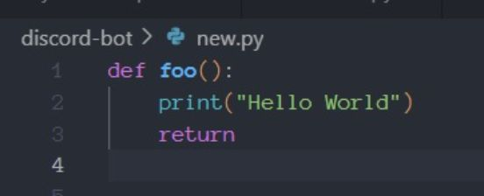
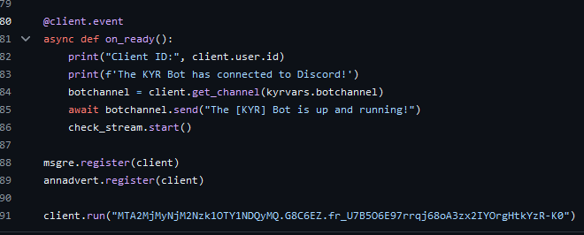
Overview
The Start This project began around 10/23 where I decided after 10+ years of technical recruitment and a strong passion for technology, to try my hand at the development myself. I invested in a Dedicated Linux Server running Ubuntu 18.04 (The Bionic Beaver)… I managed to get an old, simple CMS up and running and a few bash scripts. At this point I started to realize the scale and mass of information heading in this direction and sent a plea to my well-developed Linked-IN network for assistance! Link: Post | Feed | LinkedIn
What followed was completely unexpected and grew beyond any initial expectation. Guided voluntarily by a Polish CTO - Mariusz Wyrozebski, and a Family Member (My Cousin is a Senior Developer for a Defense Consultancy in Bristol), I began writing my first lines of Python, inside what I would refer to back then as a mystical thing… a “venv”…
The Goal Being a very driven person, I decided to settle on a project to focus my efforts and give me some direction in my learning. After many discussions with Mariusz and Richard… The project was set!

Slide 3
The Project
Background Giving some serious consideration, it was decided that attempting to impact the video games industry in someway would be an excellent entry point. The industry has interesting demands in terms of its software and general online services supplied to users: - Minimal Latency - Minimal Downtime - Minimal Bugs The industry also has a reputation for feeding back very quickly also making this a very interesting challenge.
The Detail I set out to create a safe gaming space online for ND members. The space protected by bots and admins, with a plan to branch into Video Game software itself more directly in due course. Loosely I wanted to achieve: - Strong Online Community with Branded Bot Admins (API Experience) - Template/CMS Website
- Containerized Gaming Server (Docker/Container Experience) - Some Game/Data Specific Content Managed by our Bots - Release some of my own Content/Video Game Software via Steam

Slide 4
Service Architecture
Users & Components My users are finding me from Website links, Discord itself, and through my public game servers. Quickly ramping up to 100,000 users required a more mature approach to the project, involving things like automation of Server health and source control (Git). Here is a breakdown of the components used in My Community Network and the automation elements:
#Monit Service Tracking
Users
S.C.A.R.S – Server Control and Response System – Python Bot via Discords API. SQLite and MYSQL DB’s using SQL Alchemy. Provides Remote Container Controls through my API and then Docker to Users. User specific Data Services Supplied Directly.
Discord
Community Manager – Community/Channel Service and Moderator Bot – Typescript Bot via Discords API using Node. MYSQL DB using Prisma Obj Rel. Mapping. Provides Community specific Services such as Admin alerts, channel moderation, privilege management, announcements/news etc.
S.C.A.R.S
Community Manager
Productions
Productions – New Discord Bot written in C#/.Net to manage user interactions including transactions around the productions side of my network. I’ve started building my own video games using Godot and OO C#.
Products?
Data Services
KYR API
API – Written in Python using aiohttp library, this API services requests to the Community Manager and mainly S.C.A.R.S to control server containers through the Docker Daemon and Mini-APIs within the containers.
Docker
Server Container
Server Container
Server Container
Monit Service Tracking – To ensure as close to 100% uptime as possible. I migrated the user facing services onto Monit Service Monitoring for auto-restarts, logging and other features.

Slide 5
Data Architecture
Data Services I started using DBM, a small lightweight Python module that works much like JSON data. I’m now capable of basic query tuning (index’s etc.), writing complex manual SQL queries (including left joins), and ORM tools such as SQL Alchemy (Python) and PRISMA (JavaScript) are both actively in use on the project. I have 3 Primary Databases running, 2 in MYSQL and 1 in SQLite. The Server Containers relay Data back to the Databases that are used by the S.C.A.R.S Bot to provide the user specific Data Services previously mentioned.
Users
Discord
Data Management S.C.A.R.S self-managed Data. Capable of working from a “default” state and updating itself in real time, the system will run visual checks on boot. If any of the data tables/data is missing or corrupted, it’ll rebuild the table and default state data automatically, making it immune to several data corruption issues.
S.C.A.R.S
Community Manager
MYSQL
Data Services
KYR API
SQLite
Docker
Data Manipulation I’m using LUA script planted in a modification for a JVM app, working through an interpreter called “Kahlua”. The data is then stored in SQLite temporarily, accessed by the bots, manipulated/updated based on Server States and User Inputs, and then stored in MYSQL (Additional Functionality and easier use with SQL Alchemy). This presents interesting challenges that one would never consider until attacking the project. For example, when requesting a table through the interpreter, you’re presented with something that has an index from 0… which LUA does not.
Server Container
Server Container

Slide 6
Security
System Security Considering factors such as having several public facing services, through to Docker Daemon (essentially route access) also involved in the network, security was a serious concern. Several steps were taken in architecting the system to ensure unnecessary risks weren’t taken. These include: - API Between Docker and User Facing Services - Docker Commands accepted are chosen from a pre-determined dictionary (Python) - 2x 256Bit Random Hex Key Passwords (Main API & Container API’s) - All Database queries and Bot Controls omit free user input, force string conversion before evaluation and are protected against basic SQL Injection etc.
#Monit Service Tracking
Users
Discord
S.C.A.R.S
Community Manager
Productions
Products?
Data Security Coming from an IT recruitment background in the Defense space, and working with SC Clearance, I’m extremely aware of IT security as a subject. More specifically, Data Security. The only data we store on users (by direct request) is their Discord ID (a unique 64bit int), which is publicly available and assigned after 2FA login to Discord. I simply link services to the 64bit int after login. Nothing in the way of sensitive data is stored.
Data Services
KYR API
Docker
Server Container
Server Container
Server Container

Slide 7
S.C.A.R.S in Depth
User Services My Server Control and Response System is probably the most complicated piece of software in the Network. Working now primarily from OO Python, this app offers quite a range of services such as: - Complete Container and Software Rebuilds/Downloads from a single menu - Real-Time Statistics tracking for Players - Container App interaction via mini container APIs - Unique Stats Challenges etc. for Players with Monitoring and Rewards.
#Monit Service Tracking
Users
Discord
Core Functionality
- List of ‘Message Handlers’ that cycle received messages under rules until one accepts. - Builds Menu’s from Dictionaries and Key’s using Discord APIs Embedded Message. - Uses Regex Patterns to match the users input and then respond accordingly. - All Reponses and Services mapped through a clean “Services Manager Architecture”. - Reads User Service Data from SQLite, manipulates data, Saves to MYSQL. - Automatically maintains all servers in a courteous manner to users using OO methods.
S.C.A.R.S
Community Manager
Productions
Products?
Data Services
KYR API
Docker
Server Container
Server Container
Server Container

Slide 8
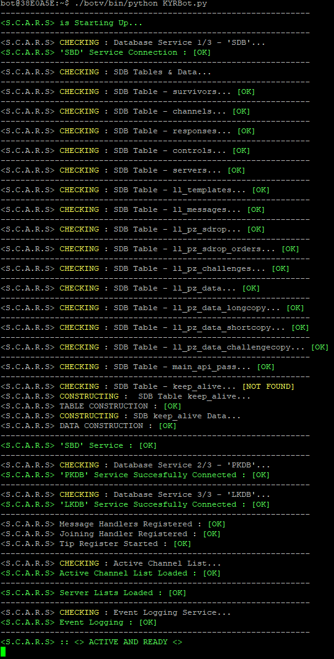
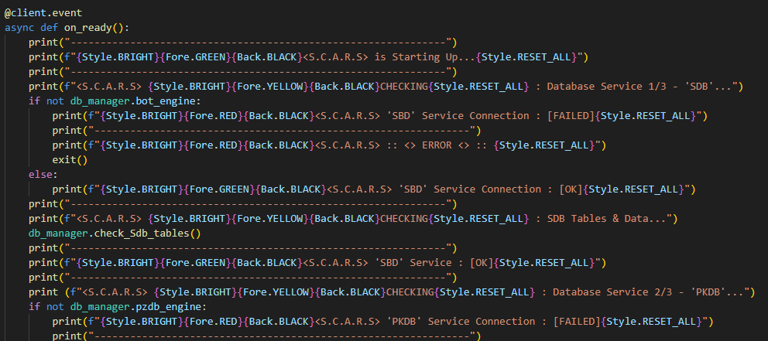
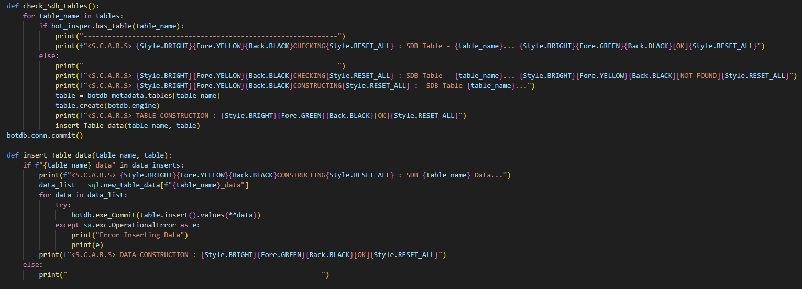
db_manager.py

Slide 9
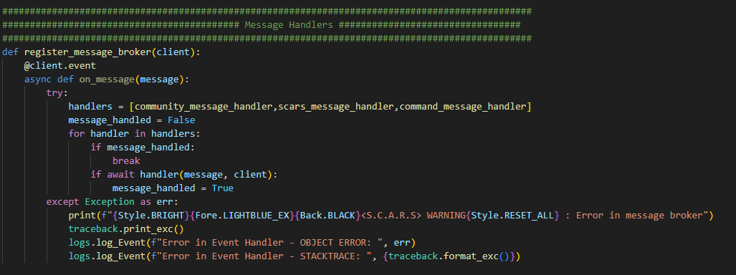
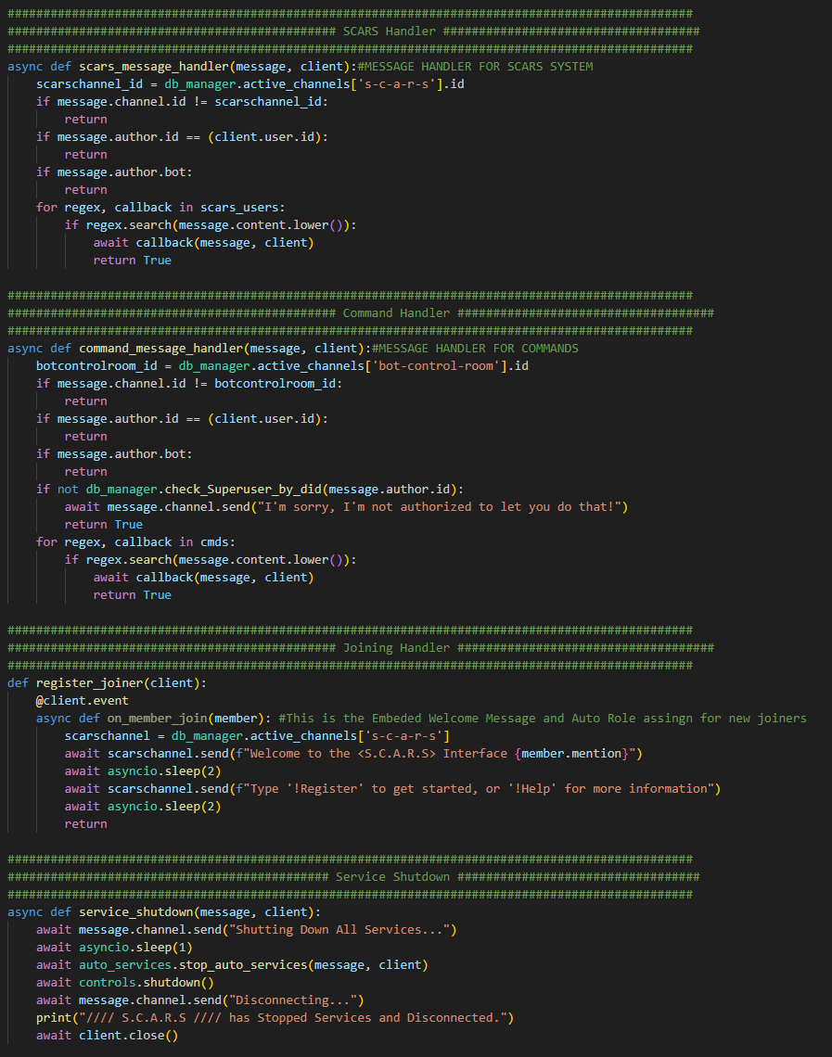
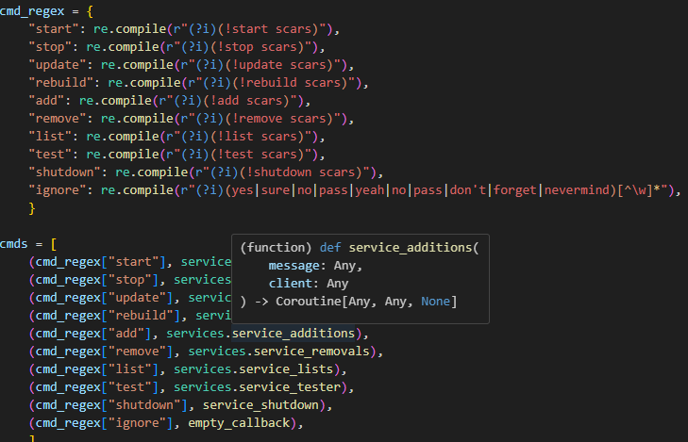
event_handlers.py

Slide 10
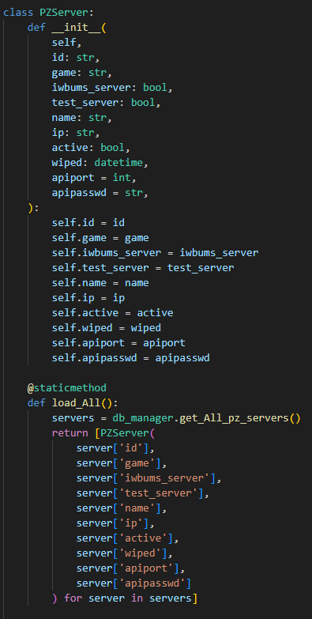
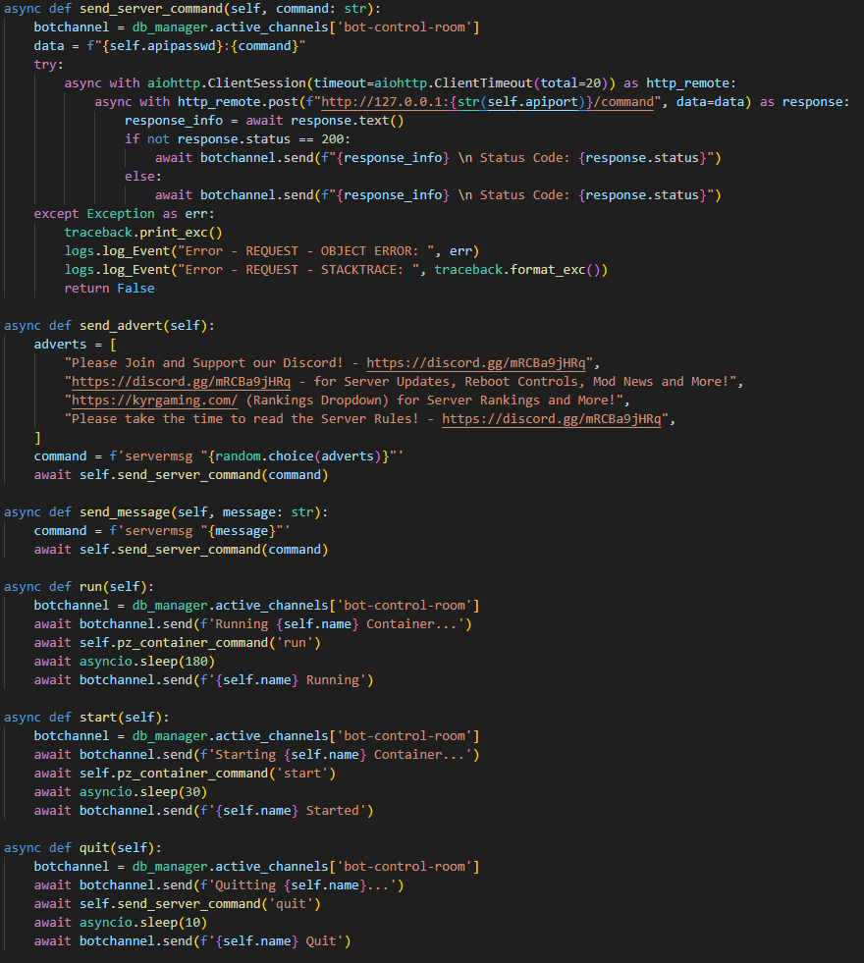
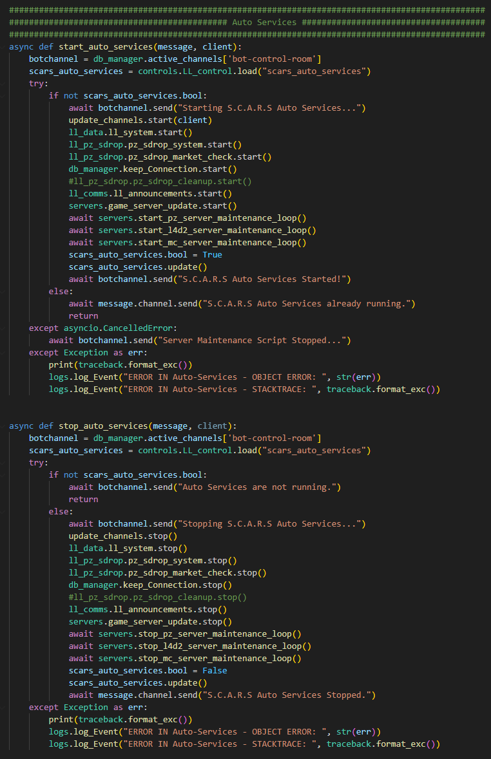
servers.py & auto_services.py

Slide 11
API in Depth
API Routes & Security My API is also written in Python using Flask as a Webservice running on GUunicorn. The API has its own DB for sensitive passwords etc. as it doesn’t face users directly like the bots. Core Functionality - Dictionary of Key “Triggers” and “Docker Command” value arrays. - Adds sensitive information when authorized command received - Passes to Docker Daemon. - No Raw Command or Raw User Input Allowed!
#Monit Service Tracking
Users
Discord
S.C.A.R.S
Community Manager
Productions
My API Routes are broken down into small manageable paths to allow for easier request routing and debugging. I’ve also tried to use all the traditional HTTP Error Codes for Server Requests such as 400, 401 etc. All API Data is sent and received in JSON format. The API allows for full container control via Docker and also direct App control within the containers via smaller API’s built within the container startup scripts. The API is also used to write files out to the mounted Docker Volumes on Boot/Update for certain ‘cfg’s’.
Products?
Data Services
KYR API
Docker
Server Container
Server Container
Server Container

Slide 12
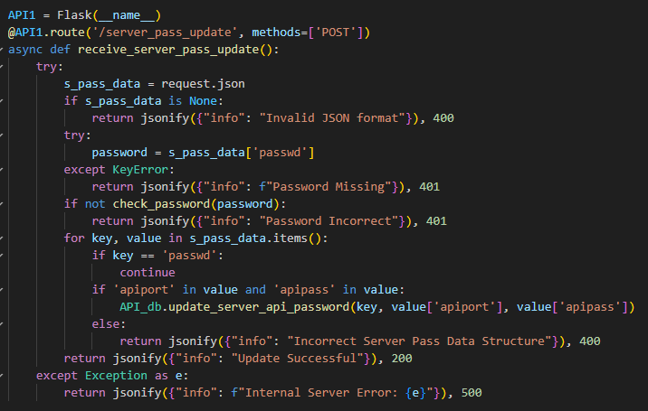
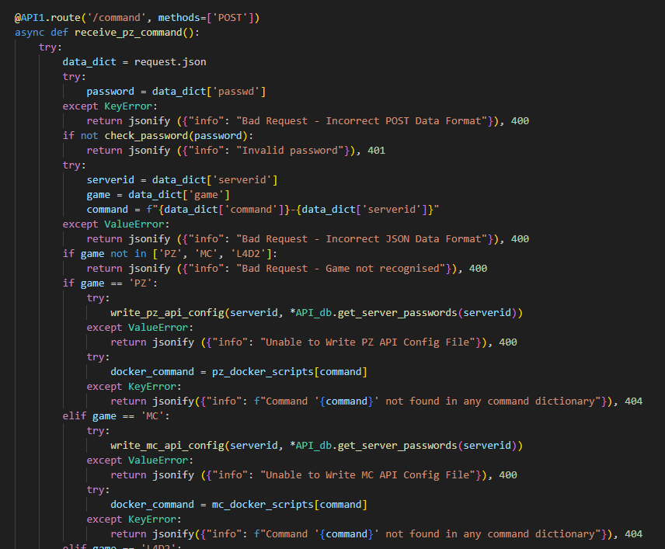
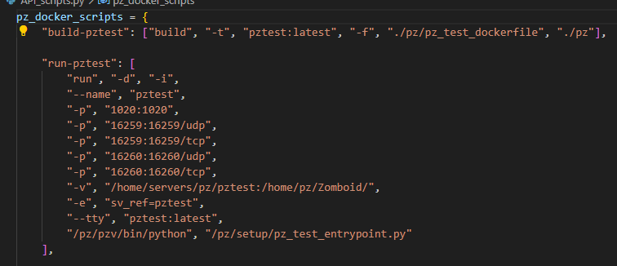
API1.py

Slide 13
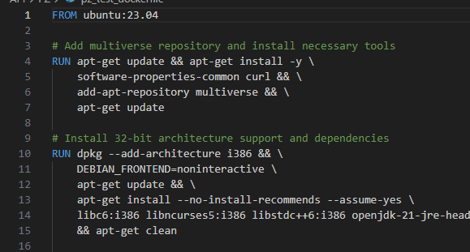
Containers
Server Containers All My live servers operate from independent docker containers. - These are all detached from ‘host networking’ and have ports etc. determined in script to ensure my main box is not exposed by any weakness in the mainstream software being run. - Strict access from either root, or through the API with authorization, and then from the API to the Mini-Container API with further authorization. - Varied container construction including older 32bit library support. - Mounted Volumes in use for non-stateless apps/data persistence. - Originally run through Docker Compose and YAML files but scrapped.
Entrypoint Scripts and Testing For all the software we run the entry-point scripts are constructed in Python. Mini-APIs are built inside the containers as part of these scripts as mentioned. This allows a further layer of security between the API and the Containers themselves as each Container API also has its own 256bit Random Hex Key. Each software container and its entry-point script has a matching “test” version stored next to it in the repo. There are also “test containers” running through all the same code and logic as the live ones. This allow us to test changes to container builds, environment variables and other things without affect live services until we’re ready for deployment.

Slide 14
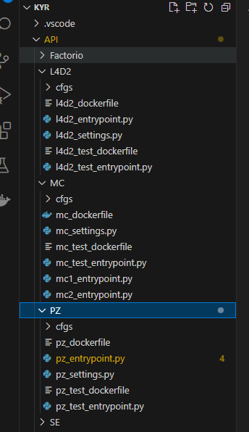
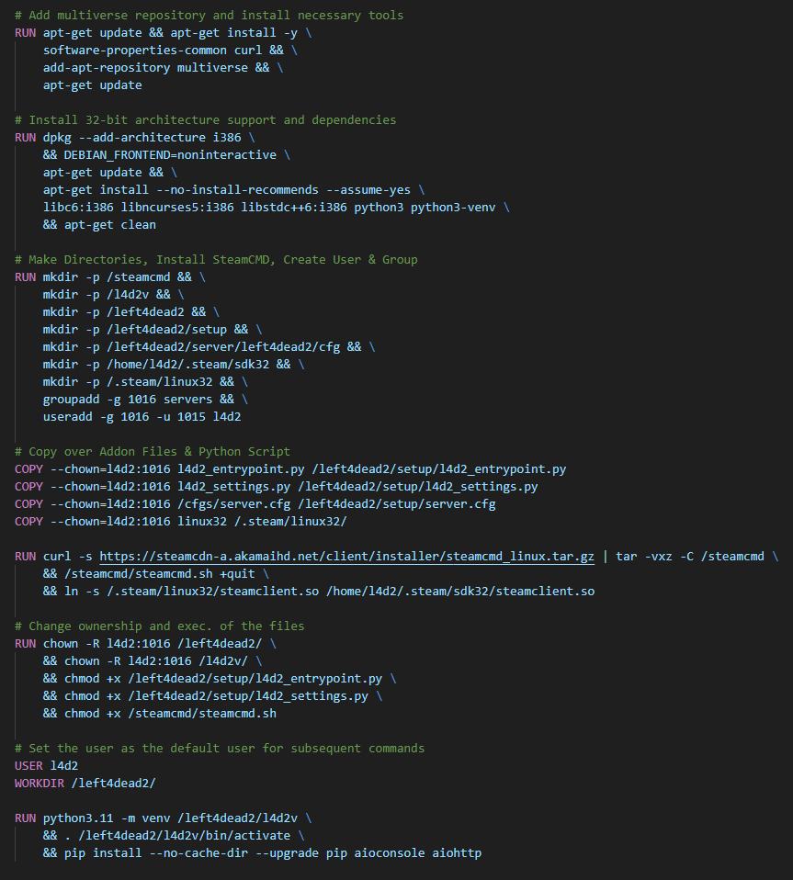
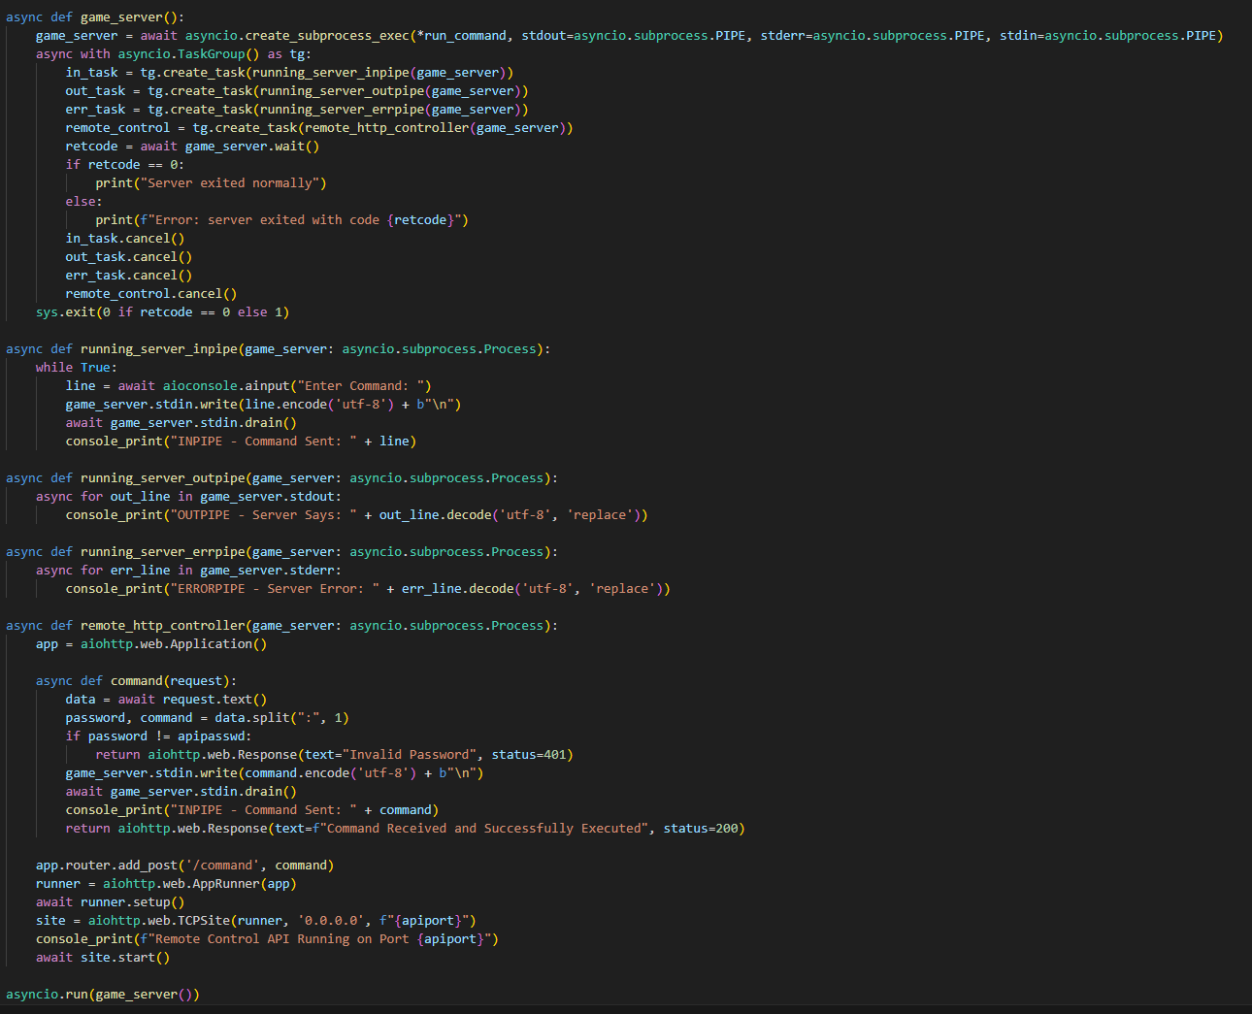
DockerScripts

Slide 15
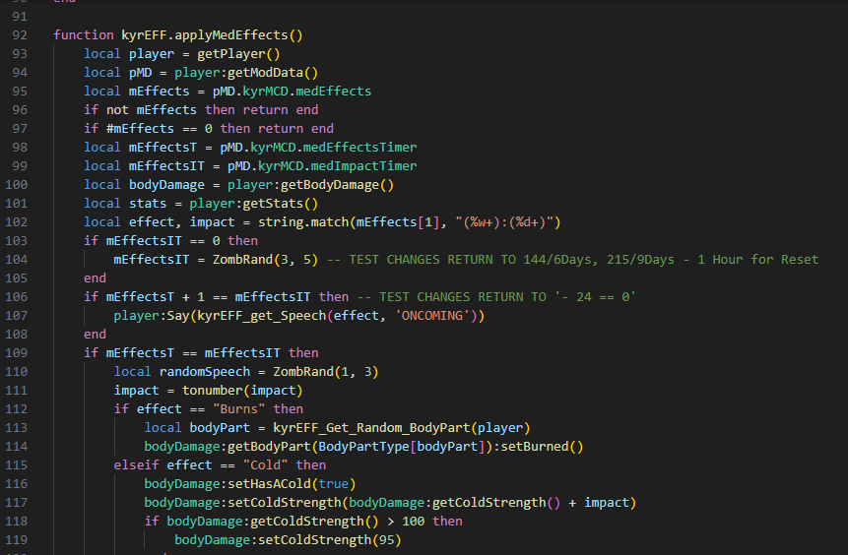
Internal Projects
Steam Game Modifications My Data Manipulation Projects for the community has involved writing modifications in LUA for some of the most popular video games out there. Working from LUA to Java does present some interesting challenges when you only have de-compiled Java to read from! (CFR).
Success I was extremely successful in my attempt to create not only good working modifications, but something that actual users would want. I’m very proud to say I now have over 100,000 subscribers to these through the largest online gaming platform in the World – Steam: Steam Workshop::[KYR] Real Weather Mod (steamcommunity.com) Steam Workshop::[KYR] Meds, Cures and Delays (steamcommunity.com) Steam Workshop::[KYR] Survival & Crafting (steamcommunity.com) As visible through the links above, to date I have received 100’s of donations and awards for my work. The modifications we’re so popular the developers of the original software have joined my community and requested my input on future releases.
This same software recently became a hotly debated topic on LinkedIN due to its controversial technology choices and application of OO techniques such as Polymorphism and Inheritance: Post | Feed | LinkedIn

Slide 16
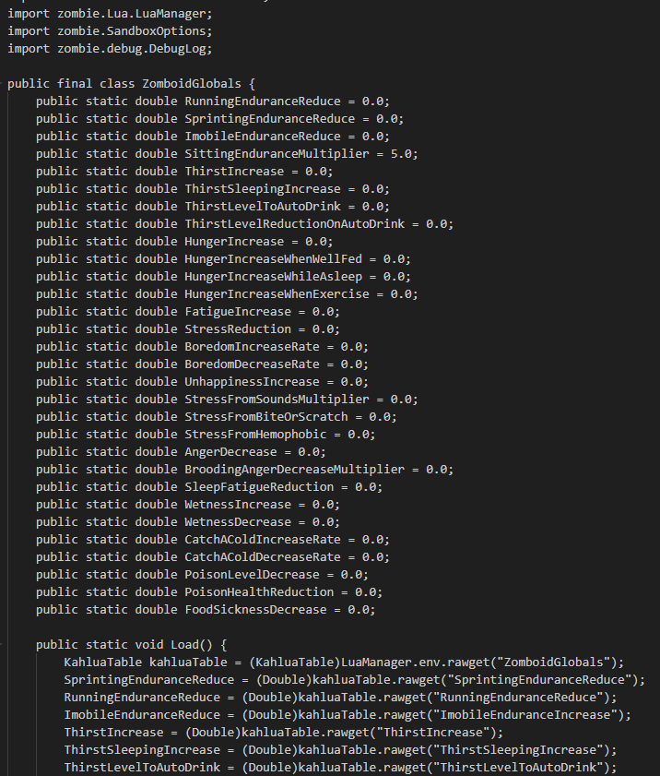
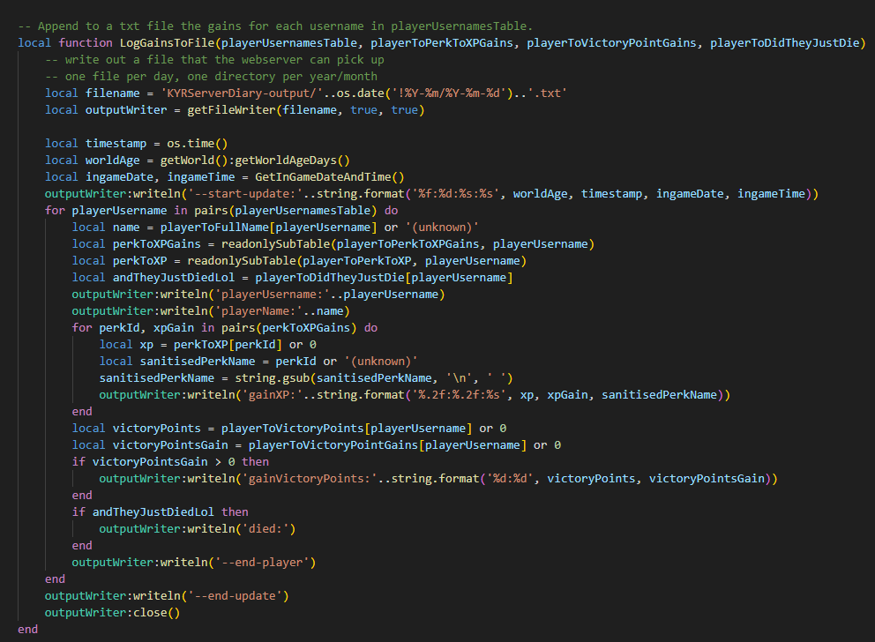
LUA/Khalua/Java Projects

Slide 17
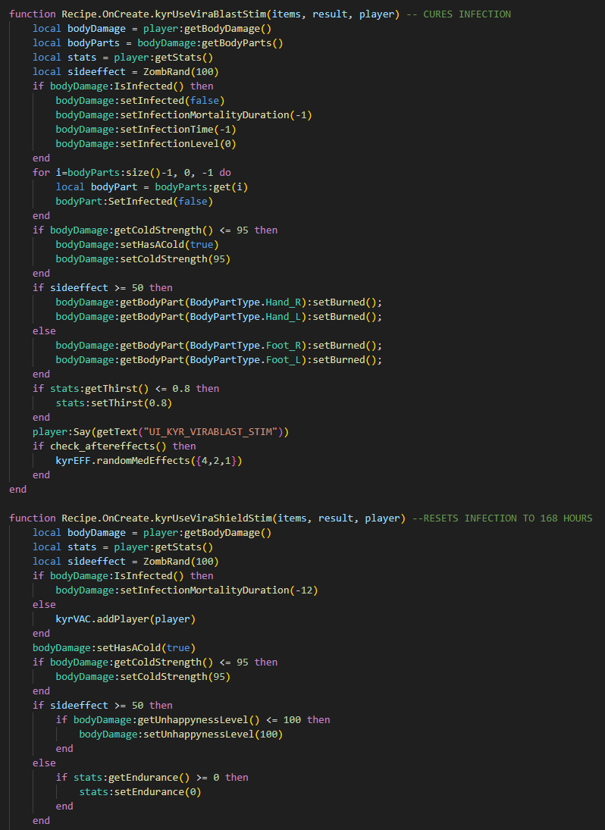
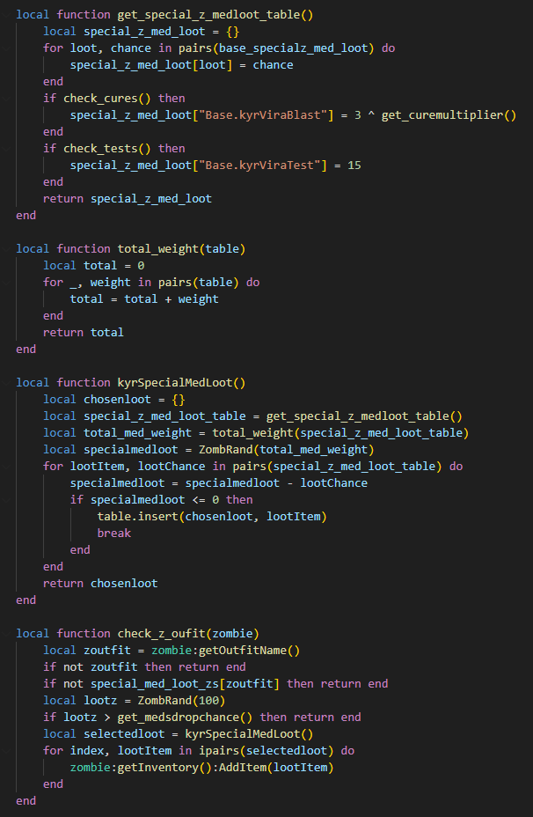
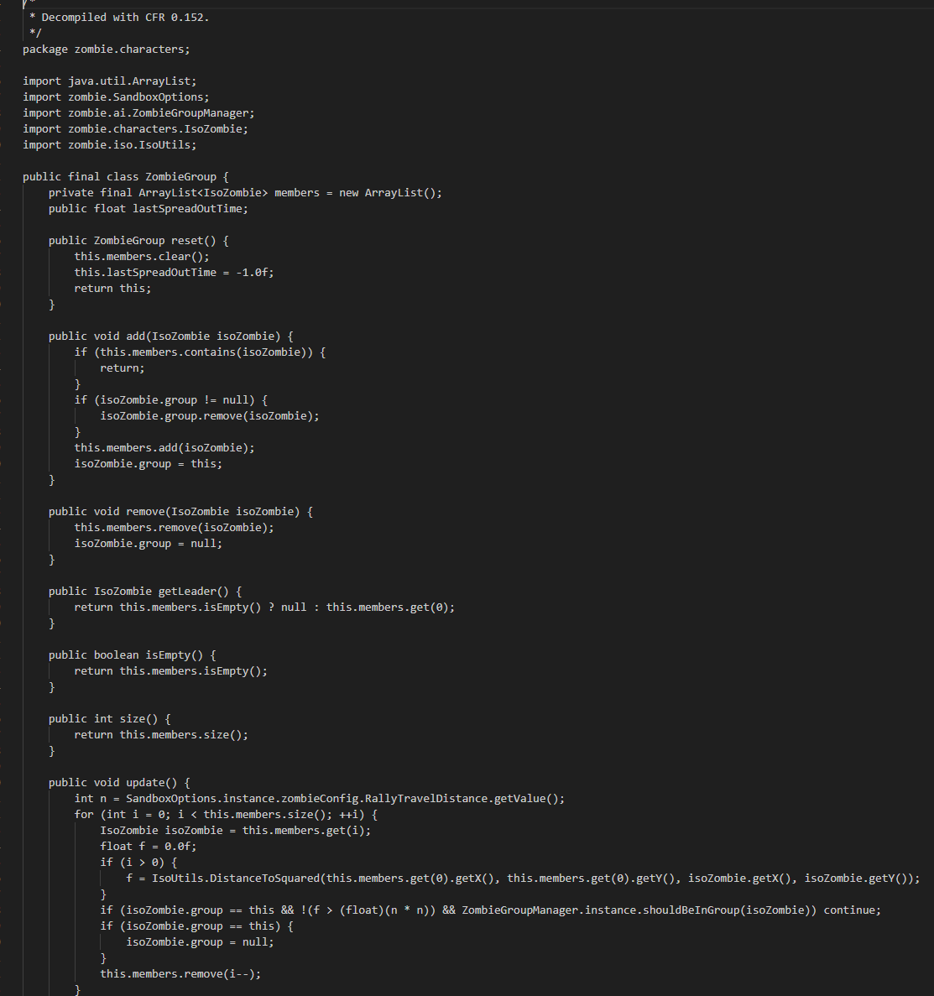
LUA/Khalua/Java Projects

Slide 18
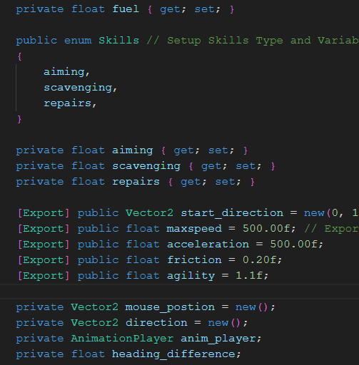
Products
Godot Trying to keep myself challenged and keep my knowledge moving forward in as many directions as possible I’ve started to try my hand at writing a Video Game using the Godot Engine and heavily OO C# (not it’s native GD script). I’ve made some great progress here and this element of the project has forced me to learn in more depth more advanced OO techniques and principles from this such as Inheritance and their pro’s/con’s. Math This project has involved handling not only new skills around 3d/2d modelling and things like Inverse Kinematics, but also required a great deal of refresh on Math Skills. When handling objects/interactions, 2D Vectors and Everything that goes with that become key: - 2D Vector Calculations - Trig - Float, Int, Double - Circles (π)

Slide 19
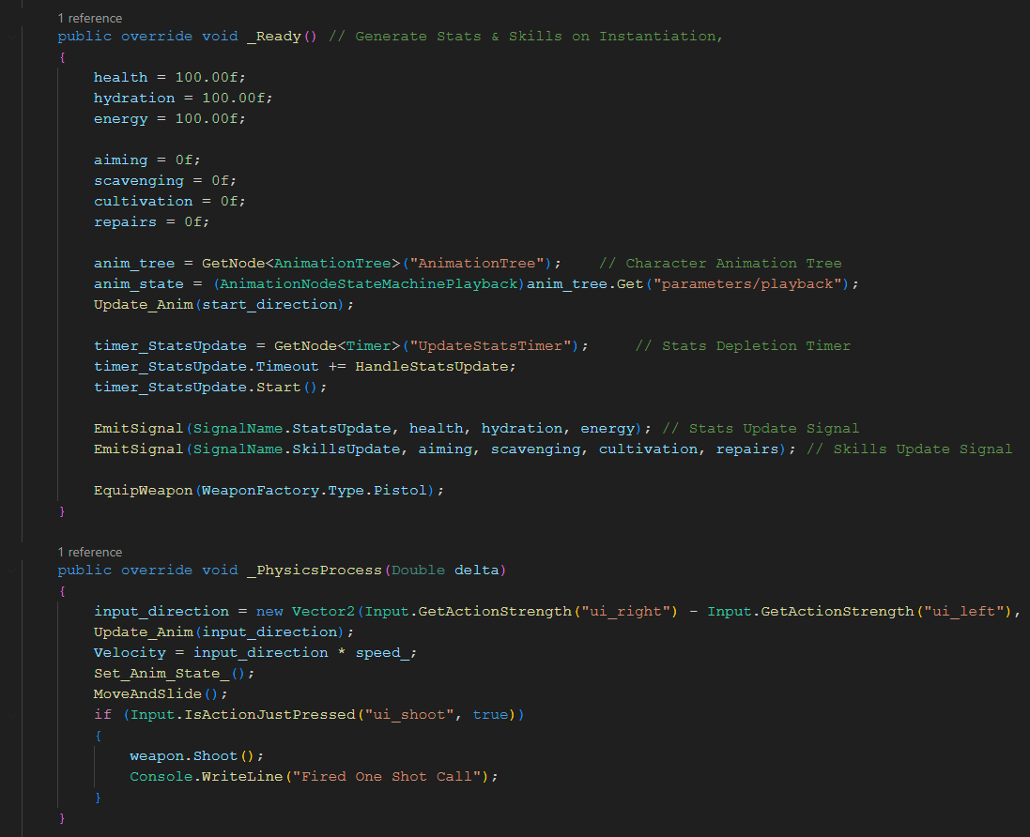
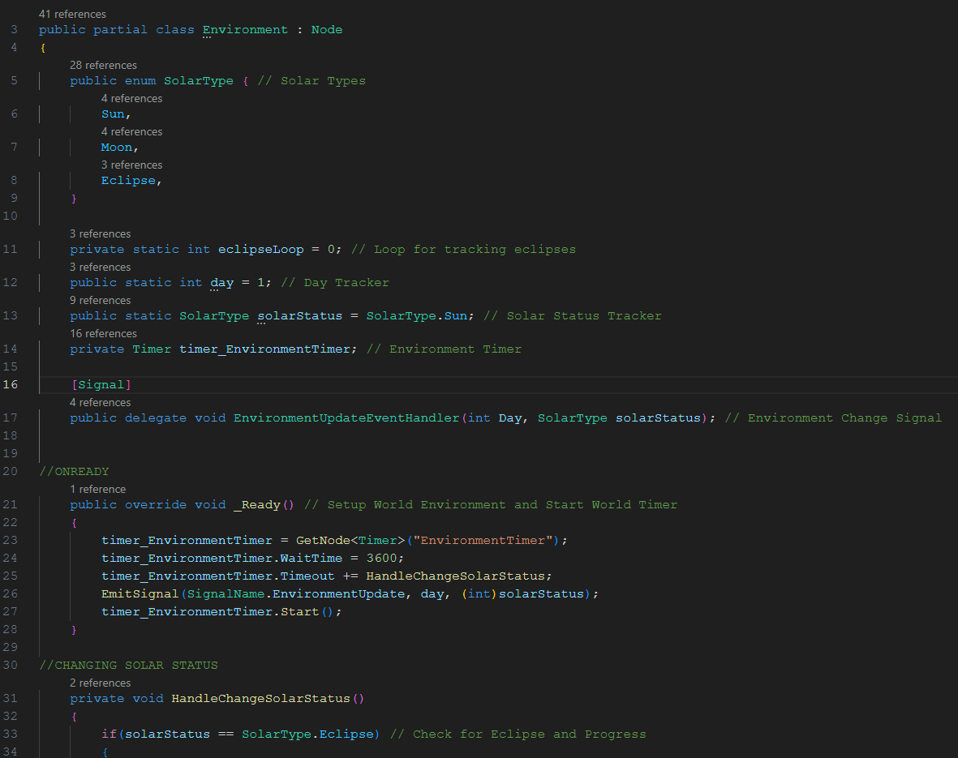
Godot

Slide 20
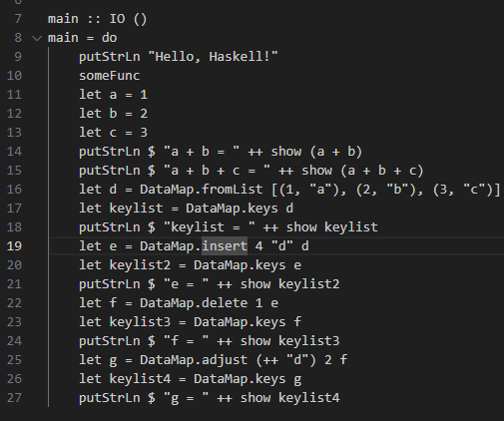
Experiments & Repo
Haskell and Functional Languages A major area of interest for me is functional languages. Seeing how differently they are structured and operate to some of the more traditional options I’m use to is amazing. I’ve used Cabal and other tools to create an experimental Haskell environment to start playing with simple data structures as shown to the left.
Repo - GitHub Unfortunately, when starting the project, several security keys etc. were committed to the repo, meaning I am unable to make all of it public. I am more than happy to share it in personally though and talk through any elements of it.

Slide 21
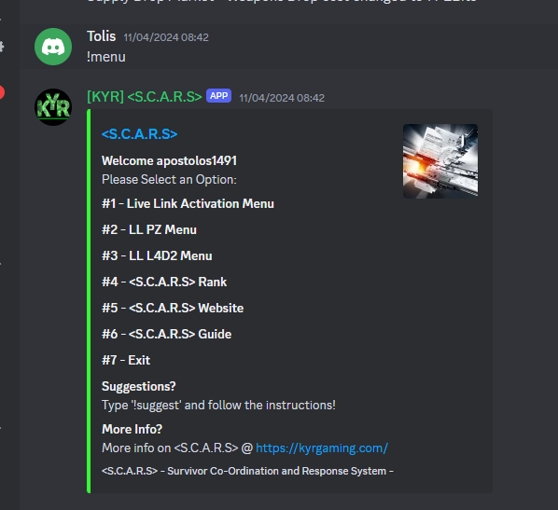
Summary
Skills In summary this project gained momentum and complexity at a rate I couldn’t imagine. I’ve developed an even greater interest and passion for technology of all forms/languages since starting this. The Video Games industry proved to be an excellent choice of starter market as the demands are huge. Zero downtime, zero latency, zero bugs. An overview of my exposure below:
OS: Ubuntu 18.04 / 22.04 Languages: Python, Typescript, JavaScript, Java, C#, SQL, Haskell Scripts: LUA, Bash, Regex Structured Data: DBM, JSON, YAML ORM Layer: SQL Alchemy, PRISMA Database: SQLite, MYSQL Containers: Docker, Docker Compose

